Slide 1
Spark Funds – INVESTMENT CASE STUDY SUBMISSION
Group Members:
Puneet Agarwal
Rakesh Gorai
Sarathbabu Sankaran
Vinayak Bandhu

Slide 2
Spark Funds – Investment Strategy
Spark funds, an asset management company, is looking for a strategic investment options based on global trends.
A solution needs to be drawn keeping below limitations and business objectives in mind.
Business Objectives:
Identifying best sectors, countries and investment type for making investment.
Extensive analysis of Investment type, sector and country needs to be done.
Limitations:
5 to 15 million USD will be investment per round.
Investment will be only in English speaking countries for ease of communication.

Slide 3
Strategic Investment Decision – Flow Chart
Data Preparation
Data Analysis
Group data on Investment type, Country and Sector
Market
Informaton file
Is English Speaking contry?
Ignore nonEnglish speaking countries
Merging and Cleaning
Data
Consider English speaking countries for investment options
Data Analysis

Slide 4
Problem Analysis
Understanding Data:
Companies – this dataset has information about companies and their categories
Rounds – Investment preferences of the companies. Like amount, investment type, etc.,
On high level following are stages in the workflow:
Gather data for the analysis
Clean the data for readability
Collate data in to a model
Filter model based on Investment type, Country and Sector
Identify best possible investment options
Plot on the option for graphical representation.
Tools for the workflow:
Python Language is used for data cleansing and modelling by using Anaconda IDE.
Tableau is used for plotting the results

Slide 5
Data Model Analysis
Data quality is crucial for this step. We have companies, rounds and mapping information in files. This needs to be cleansed and built into a model.
Building model Python-Pandas is extensively used and following stages are addressed in building model:
• Data Import – Import data from Companies.txt and rounds2.xlxs.
• Data Cleansing –Removing or correcting dirty data. Handling of NA values.
• Data Merging – Merge companies and investment round data to get fully readable dataframe based on unique key company parmalink field.
• Data Mapping – Mapping dataset for identifying sectors and investment preferences and also define the missing mappings by mapping the primary sectors to the nearest logical main sector.
• Filtering – To identify preferred investment options for Spark Funds to invest.
• Exporting Data – For tableau plotting data is exported.
• Floating data - To identify funding types,countries and sector.
Model Objectives – based on above model following are the primary goals.
• Investment type analysis: ability to identify best suited categories for the investment.
• Country Analysis: list out countries having most investment in the past.
• Sector Analysis: understanding investment distribution among sectors.

Slide 6
Result Analysis
Based on the bussiness model, below are the representations done.Spark Funds can easily deduce required results form the mode.
1. Data cleaning : Identify unique companies and handle NAN values for raised_amout_usd.
2. Funding type analysis : List average funding for each of investment types. (Venture, Angel, Seed and Private Equity type).
3. Country wise analysis : Country-wise funding in sectors for any chosen investment type. List top 9 countries for investment type chosen and Listing the top 3 English speaking countries for identifying investment-friendly options.
4. Sector Analysis : Sector-wise investment in each country. Total number of investments and total value of investment in USD. Top, second and third best sectors based on count of investments. Number of investments in top, second and third best sectors. Which companies received highest investment in top and second best sectors.
5. Ploting the Graph : Graphical representation done in Tableau and displayed in next sections of the presentation and Data Cleaning.

Slide 7
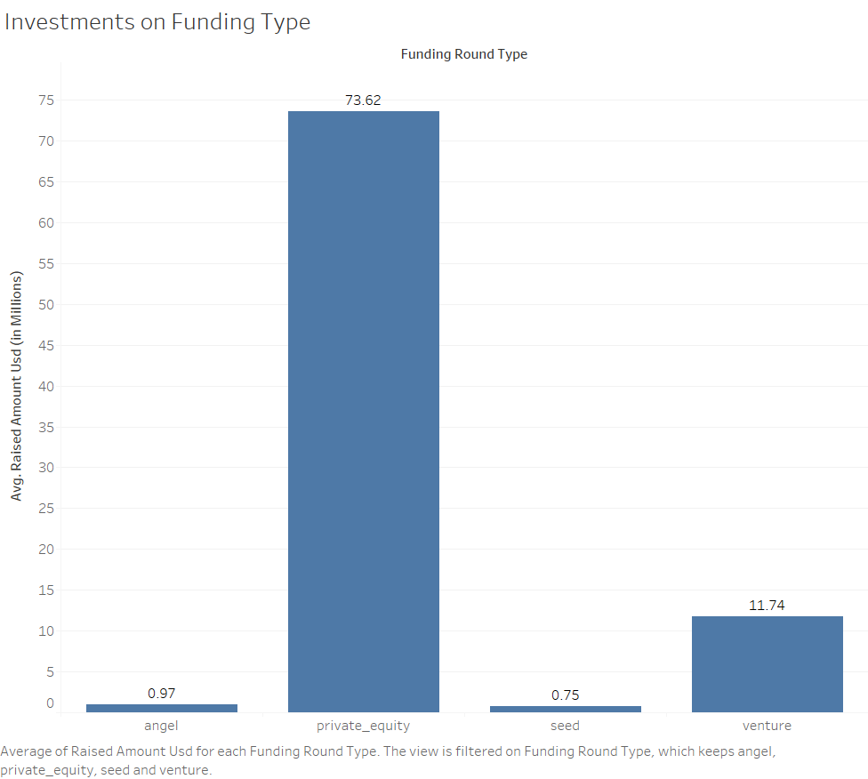
Investments based on Funding Type (FT)
Bar chart showing the fraction of total investments (globally) in venture, seed and private equity and the average amount of investment in each funding type.

Slide 8
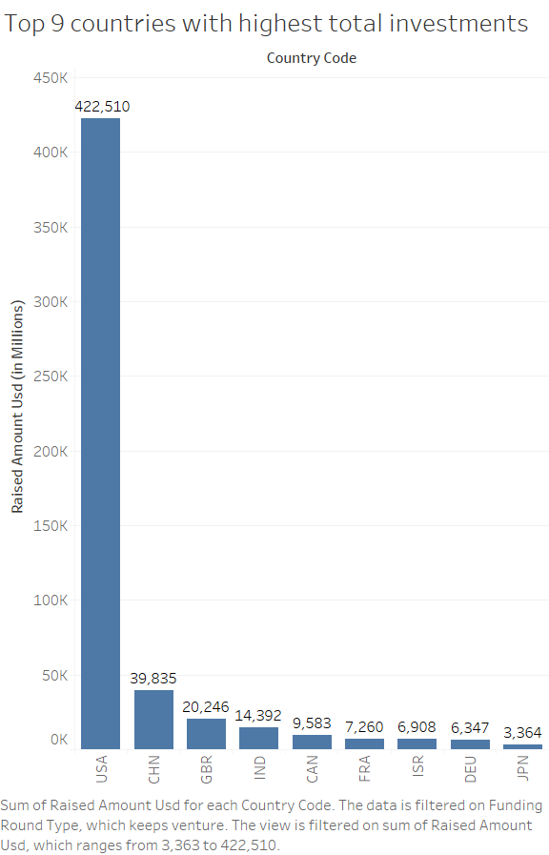
Total amount of investments among top 9 countries
Bar chart showing top 9 countries against the total amount of investments & funding type FT. This will help to make the top 3 countries

Slide 9
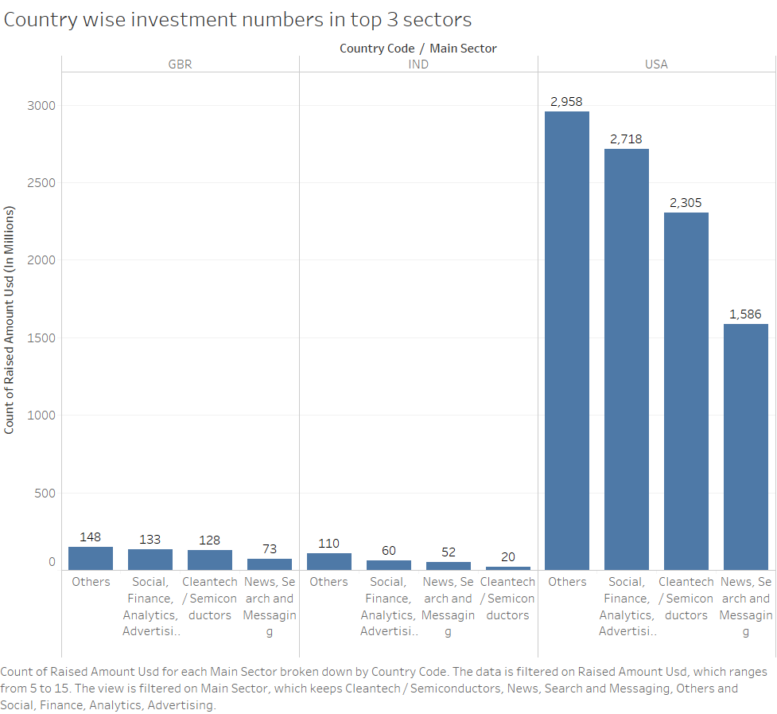
Number of Investments in top 3 sectors among preferred countries
Bar chart shows the number of investments in the top 3 sectors of the top 3 countries on one chart (for the chosen investment type-FT).

Slide 10
Inferences
Based on analysis, Spark fund should invest in the following countries:
Invest in countries | Investment Sectors
USA | • Others • Cleantech/Semiconductors • Social/Finance/Analytics/Advertising
GBR (Great Britain) | • Others • Social/Finance/Analytics/Advertising • Cleantech/Semiconductors
India | • Social/Finance/Analytics/Advertising • News, Search and Messaging • Entertainment

